Slide 1

Data Science Bootcamp at Spark Summit
Analyze Data and Build a Dashboard with PixieDust
San Francisco, June 2017
David Taieb
Distinguished Engineer
Developer Advocacy
IBM Watson Data Platform
@DTAIEB55
David Taieb
Distinguished Engineer
Developer Advocacy
IBM Watson Data Platform
@DTAIEB55

Slide 2
What you will learn in this Workshop
How to use Jupyter Notebooks to load, visualize and analyze data
IBM Data Science Experience (DSX)
PixieDust open source Python Library
How to build a dashboard using PixieApps
San Francisco Open Data
Mapbox GL

Slide 3
Info before we start
The tutorial can be followed from a local Jupyter Notebook environment. However, the instructions and screenshots here walk through the notebook in the DSX environment.
A corresponding notebook is available here: http://ibm.biz/PixieDustBootcampSFNotebook
For best results, use the latest version of either Mozilla Firefox or Google Chrome.

Slide 4
DSX
DSX is an interactive, collaborative, cloud-based environment where data scientists, developers, and others interested in data science can use tools (e.g., RStudio, Jupyter Notebooks, Spark, etc.) to collaborate, share, and gather insight from their data

Slide 5
Sign Up
DSX is powered by IBM Bluemix, therefore your DSX login is same as your IBM
Bluemix login. If you already have a Bluemix account or previously accessed DSX you may proceed to the Sign In section. Otherwise, you first need to sign up for an account.
From your browser:
Go to the DSX site: http://datascience.ibm.com
Click on Sign Up
Enter your Email
Click Continue
Fill out the form to register for IBM Bluemix

Slide 6
Sign In
From your browser:
Go to the DSX site: http://datascience.ibm.com
Click on Sign In
Enter your IBMid or email
Click Continue
Enter your Password
Click Sign In

Slide 7
Create a blank new notebook
You will need to create a noteboook to experiment with the data and a project to house your notebook. After signing into DSX:
On the upper right of the DSX site, click the + and choose Create project.
Enter a Name for your project
Select a Spark Service
Click Create
From within the new project, you will create your notebook:
Click add notebooks
Click the Blank tab in the Create Notebook form
Enter a Name for the notebook
Select Python 2 for the Language
Select 1.6 for the Spark version
Select the Spark Service
Click Create Notebook

Slide 8
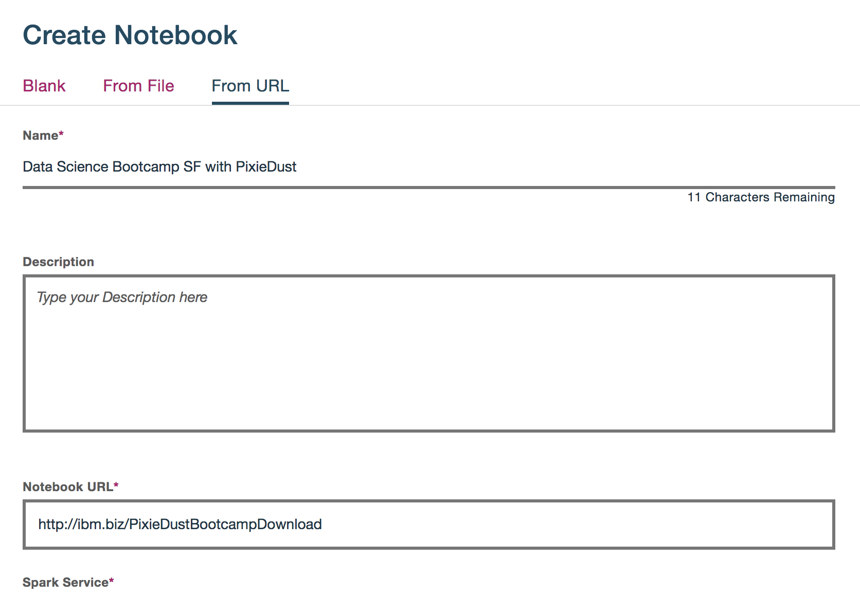
You can also import the complete notebook
Skip this page if you prefer to start from a blank notebook.
Click add notebooks
Click the From URL tab in the Create Notebook form
Enter a Name for the notebook
In the Notebook URL enter: http://ibm.biz/PixieDustBootcampDownload
Click Create Notebook

Slide 9
Make sure your Notebook is in Edit Mode
When you use a notebook in DSX, you can run a cell only by selecting it, then going to the toolbar and clicking on the Run Cell (▸) button. When a cell is running, an [*] is shown beside the cell. Once the cell has finished the asterisks is replaced by a number.
If you don’t see the Jupyter toolbar showing the Run Cell (▸) button and other notebook controls, you are not in edit mode. Go to the dark blue toolbar above the notebook and click the edit (pencil) icon.

Slide 10
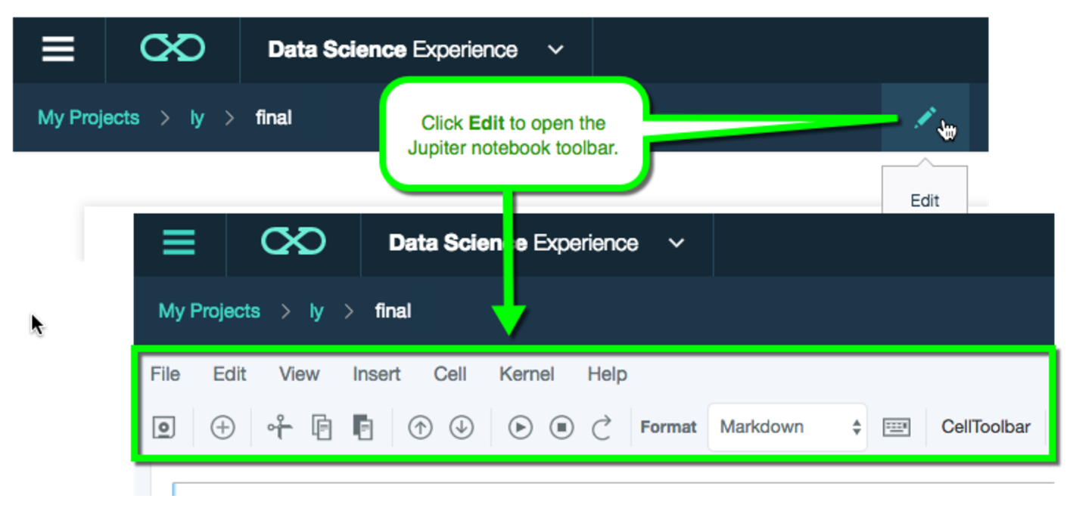
Edit Mode

Slide 11
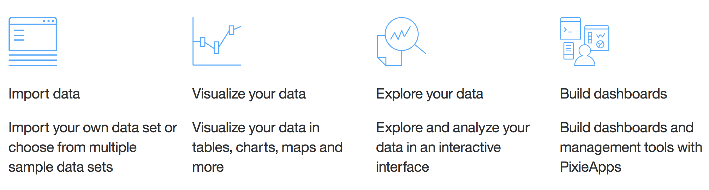
PixieDust
You can find detailed info on PixieDust here: http://ibm.biz/wdp-pixiedust
In this section, we’ll show how to use the PixieDust Open Source Python library within a Notebook to:

Slide 12
Make sure PixieDust is at the latest version
DSX already comes with the PixieDust library installed, but it is always a good idea to make sure you have the latest version
In the first cell of the notebook enter: !pip install --upgrade pixiedust
Click on the Run Cell (▸) button
After the cell completes, if instructed to restart the kernel, from the notebook toolbar menu:
Go to > Kernel > Restart
Click Restart in the confirmation dialog
Note: The status of the kernel briefly flashes near the upper right corner, alerting when it is Not Connected, Restarting, Ready, etc.

Slide 13
Import PixieDust
Before, you can use the PixieDust library it must be imported into the notebook
In the next cell enter:
import pixiedust
Click on the Run Cell (▸) button
Note: Whenever the kernel is restarted, the import pixiedust cell must be run before continuing.
PixieDust has been updated and imported, you are now ready to play with your data!

Slide 14
Import San Francisco traffic accidents data
It would be a good idea to spend a few minutes browsing the San Francisco open data site: https://datasf.org/opendata/
Load the data: With PixieDust, you can easily load CSV data from a URL into a PySpark DataFrame in the notebook.
In a new cell, enter:
accidents = pixiedust.sampleData("https://data.sfgov.org/api/views/vv57-2fgy/rows.csv?accessType=DOWNLOAD")

Slide 15
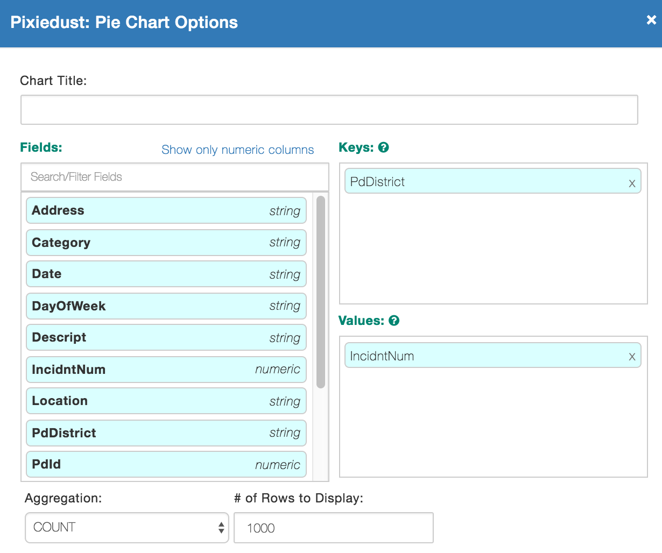
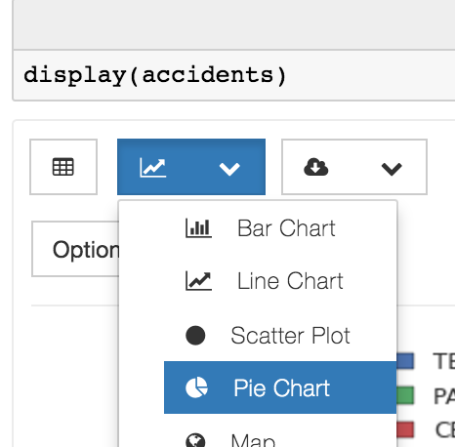
Explore the Data
In the next few cells, we’ll use the PixieDust display() to interactively explore the data. This tutorial will provide a few suggestions for which options to choose, but feel free to also explore on your own.
For example:
(Pie Chart - Options: Keys = PdDistrict, Values = IncidntNum, Aggregation = Count)

Slide 16
Initial Exploration
Let’s start exploring our data by answering the following questions
In which police district do the most traffic accidents occur?
(Pie Chart - Options: Keys = PdDistrict, Values = IncidntNum, Aggregation = Count)
We can also dig one level deeper by clustering by how each accident was resolved:
(Cluster By: Resolution)
On what day of the week do the most traffic accidents occur?
(Bar Chart - Options: Keys = DayOfWeek, Values = IncidntNum, Aggregation = Count)

Slide 17
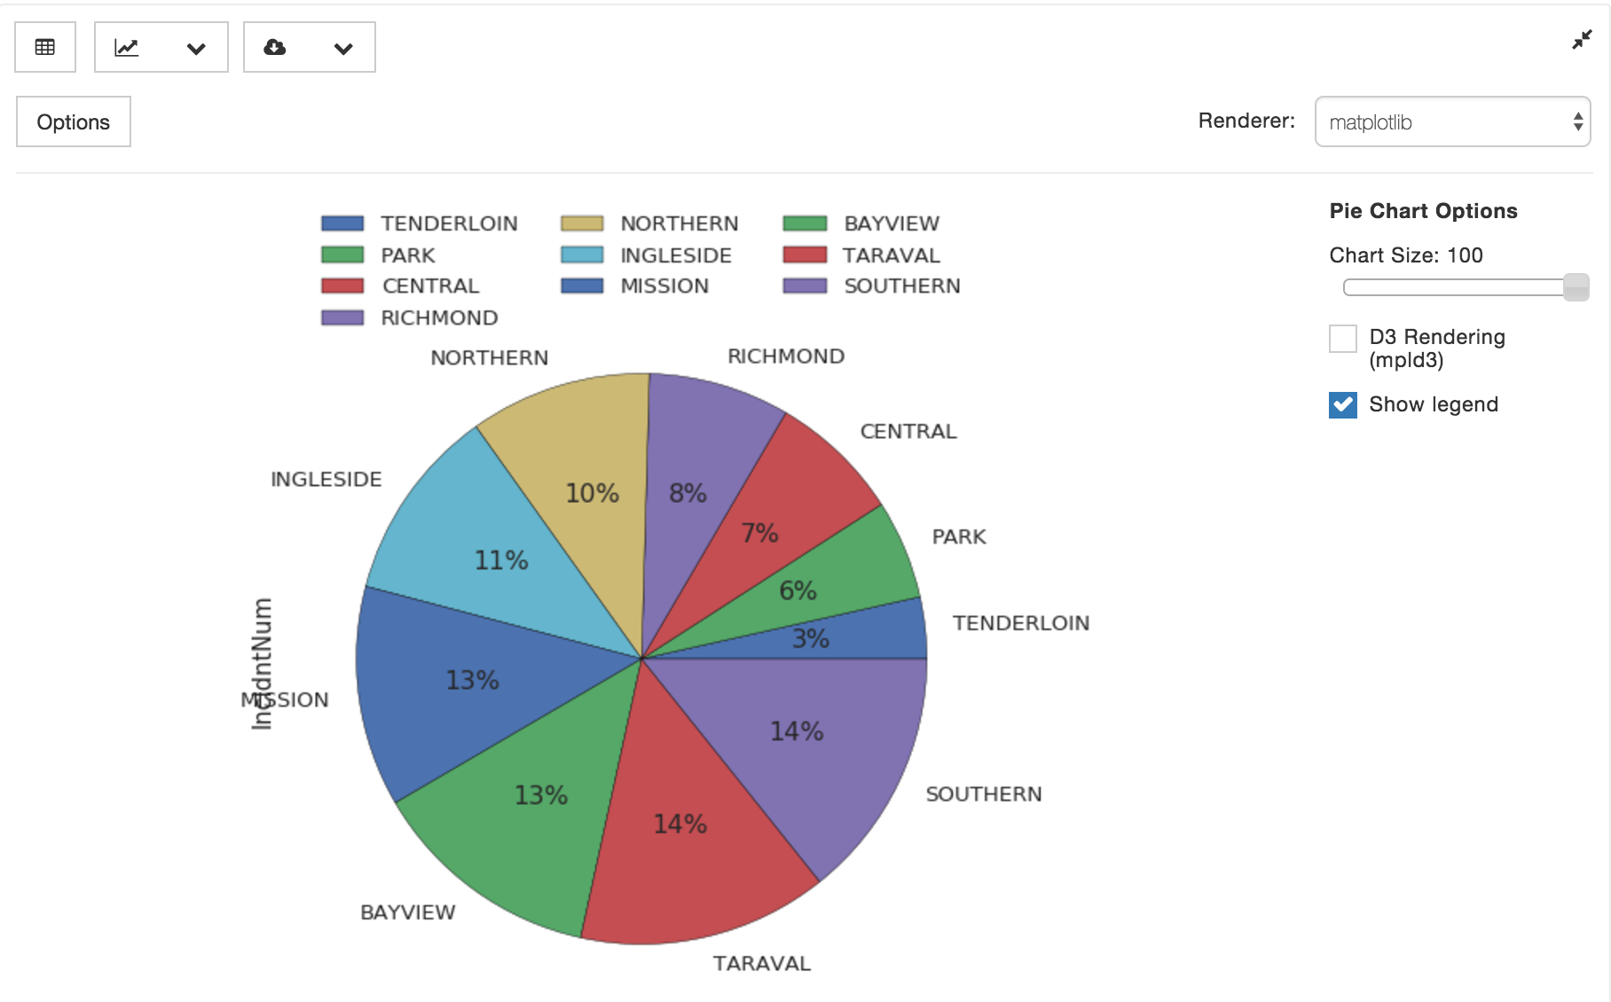
Results
Menu to select type of viz to display
Chart Options Dialog
Renderer Selector
Chart Rendering area
Dynamic Options (depend on the type of chart and renderer)

Slide 18
More data exploration and hypothesis
Immediately, we can identify a couple of areas of interest in our data without having to write a single line of code:
Most accidents happen in the Southern and Taraval police districts
Most accidents happen on Wednesdays and Thursdays.
We can also see that our data needs some cleansing if we want to make analysis easier:
The Time field needs to be converted into its time components
Rename the DayOfWeek values so they are rendered in alphabetical order
We should condense the outcome types of each traffic accident if we want to see the most common resolutions of traffic accidents in each police district, since the clustering above was unclear.

Slide 19
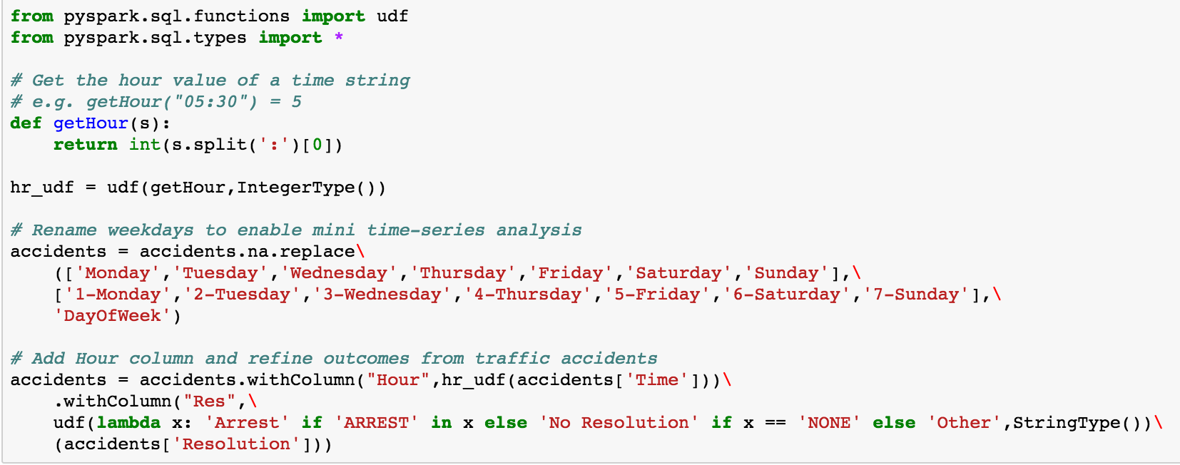
Cleansing the data

Slide 20
More exploration on the cleansed data
Hypothesis: Do accidents in one police district result in more arrests than other police districts?
(Bar Chart - Options: Keys = PdDistrict, Values = IncidntNum, Aggregation = Count, Cluster By: Res)
Question: How does the number of accidents change over the course of the week?
(Line Chart - Options: Keys = DayOfWeek, Values = IncidntNum, Aggregation = Count)

Slide 21
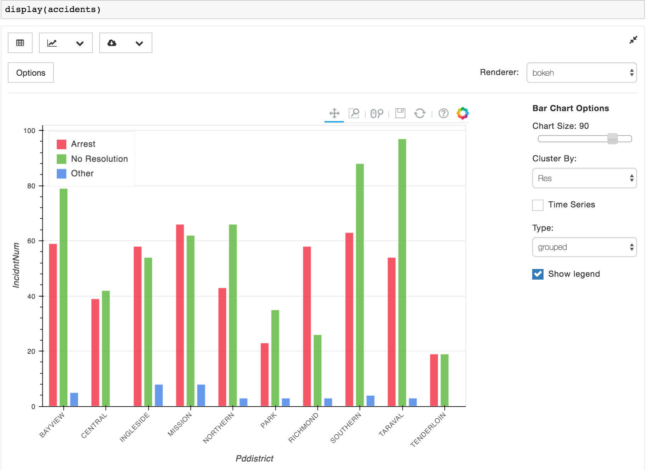
Some more results

Slide 22
What have we learned
A few lines of code makes it a lot easier to see that:
Accidents in the Richmond police district are much more likely to result in arrest than all other districts
The number of accidents peaks during the middle of the week, but decreases afterwards as the week winds down.
Now let's focus on the Taraval police district using some friendly SQL notation

Slide 23
Let’s use Spark SQL to focus on TARAVAL
In a new cell, enter the following code to create a temporary SQL Table so we can then use regular a SQL query to select the accidents from TARAVAL.
The results are then stored in a new Spark DataFrame
accidents.registerTempTable("accidents")
taraval = sqlContext.sql("SELECT * FROM accidents WHERE PdDistrict='TARAVAL'")

Slide 24
Exploration on TARAVAL accidents
Question: Where in Taraval do most accidents happen?
(Map - Options: Keys = [X,Y], Values = IncidntNum, Aggregation = Count,
Renderer: mapbox, kind: chloropleth-cluster)
Question: What time of day do most accidents occur?
(Line Chart - Options: Keys = Hour, Values = IncidntNum, Aggregation = Count)
Note: The Notebook comes with a public Mapbox access token. You can also create your own free Mapbox access token at the following url:
https://www.mapbox.com/help/create-api-access-token/

Slide 25
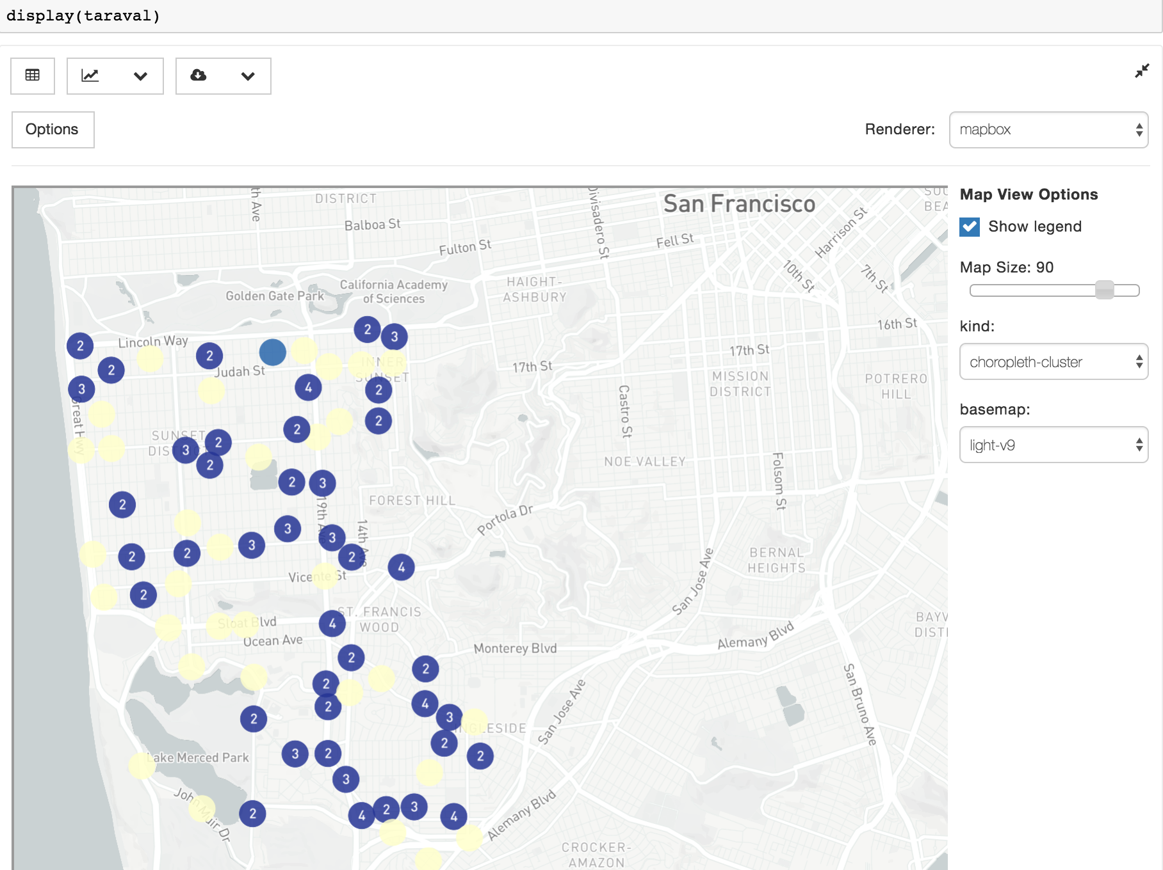
Map Visualization

Slide 26
Let’s recap
Most of the results from looking at the accident times are unsurprising:
Less accidents during very early morning (people probably sleeping)
Steady increase in number of accidents during morning commuting hours
Less accidents during mid-evening (people probably eating dinner)
(Sadly) more accidents late at night.
The interesting thing here is the sudden spike in accidents during mid-afternoon (2-3PM) - twice as many accidents happen during this two-hour window!
In the next section, we’ll bring more data to find more insights on the data. But instead of writing more code in linear cells, we’ll build a dashboard using another PixieDust feature called PixieApps

Slide 27
What are PixieApps
PixieApps are Python classes that let you write UI for your analytics
Easy to build: mostly HTML and CSS with some custom attributes
Leverage PixieDust Display visualization for charting
With PixieApps you can:
Create different html views with routes to invoke them
Invoke Python Scripts from user interactions
Run in the notebook cell output or in a Dialog
and much more…
Use cases:
Dashboards
Data Browsers
Data Pipeline Management
Note: Please take the time to browse the PixieApp documentation page here: https://ibm-cds-labs.github.io/pixiedust/pixieapps.html

Slide 28
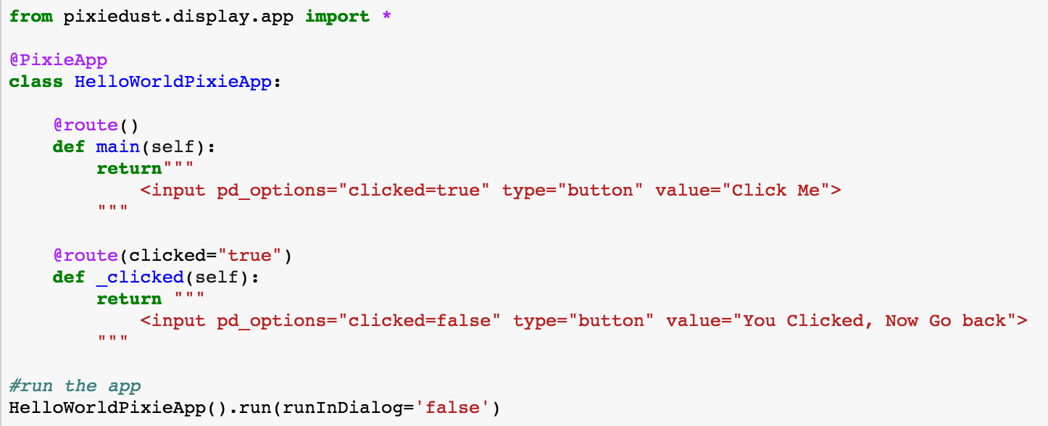
PixieApp Hello Word
Import app package to start things off
Simple annotation to tell PixieDust it’s an app
set option clicked to true when button is pushed, so that correct route is loaded next
Define the default route (no args).
Method will return the view’s html fragment
Define a new route that triggers when option clicked is set to true
Html fragment for the view.
Allows Jinja2 template macros
Import app package to start things off

Slide 29
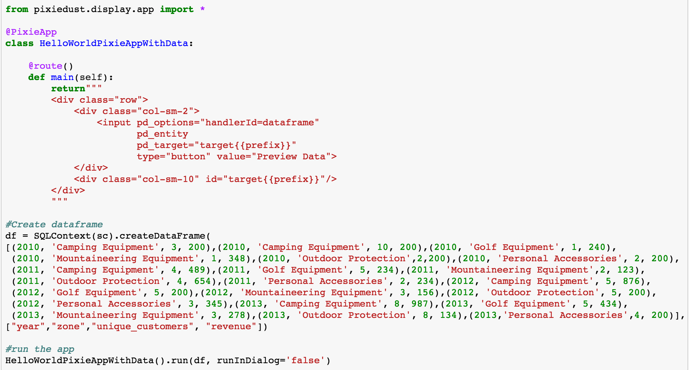
PixieApp HelloWorld with Data
Specify Display options for visualization
Entity binding: use the df passed by user
Allows binding of any entity created by the app
Display the output in the specified target
Placeholder div for displaying data
Pass data to the app

Slide 30
Back to our San Francisco Data
In analyzing the geographical data, we can see a couple of clusters where accidents occur more frequently in Taraval - the southeastern corner looks particularly crowded.
Some useful questions to ask at this point are:
Does crime has an effect on the number of accidents?
Are there more accidents in these areas because more people speed there
Do traffic calming devices reduce the number of accidents?
Note: In the next section, we’ll download datasets from the San Francisco Open Data Web site: https://datasf.org/opendata

Slide 31
PixieApp Dashboard
Step 1: Create the skeleton
from pixiedust.display.app import *
@PixieApp
class SFDashboard():
def mainScreen(self):
return """
<div class="well">
<center><span style="font-size:x-large">Analyzing San Francisco Public Safety data with PixieDust</span></center>
<center><span style="font-size:large"><a href="https://datasf.org/opendata" target="new">https://datasf.org/opendata</a></span></center>
</div>
<div class="row">
<div class="form-group col-sm-2" style="padding-right:10px;">
<div><strong>Layers</strong></div>
</div>
<div class="form-group col-sm-10">
<div id="map{{prefix}}”/>
</div>
</div>
“””

Slide 32
PixieApp Dashboard
Step 2: Create the map of accidents
from pixiedust.display.app import *
@PixieApp
class SFDashboard():
def mainScreen(self):
return """
<div class="well">
<center><span style="font-size:x-large">Analyzing San Francisco Public Safety data with PixieDust</span></center>
<center><span style="font-size:large"><a href="https://datasf.org/opendata" target="new">https://datasf.org/opendata</a></span></center>
</div>
<div class="row">
<div class="form-group col-sm-2" style="padding-right:10px;">
<div><strong>Layers</strong></div>
</div>
<div class="form-group col-sm-10">
<div id="map{{prefix}}” pd_entity pd_options="{{this.formatOptions(this.mapJSONOptions)}}"/>
</div>
</div>
“””
What have we added:
pd_entity: tell PixieDust which dataset to work on
pd_options: Contains the PixieDust options for the map (see next slide for more info)

Slide 33
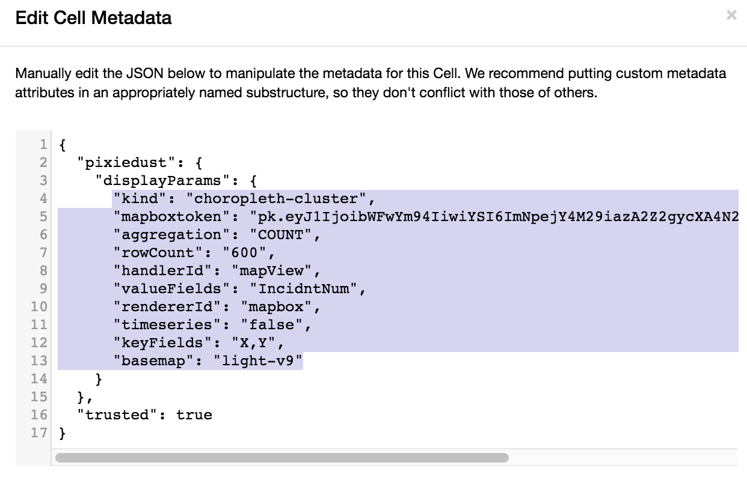
Generating the pd_options for the Map
The best way to generate the pd_options for a PixieDust visualization is to:
Call display() on a new cell
Graphically select the options for your chart
Select View/Cell Toobar/Edit metadata menu
Click on the “Edit Metadata” button and copy the pixiedust metadata

Slide 34
Format the PixieDust JSON Metadata
To conform to the pd_options notation, we need to transform the PixieDust JSON metadata into an attribute string with the following format:
“key1=value1;key2=value2;…”
To make it easier, we use the a simple python transform function:
def formatOptions(self, options):
return ';'.join(["{}={}".format(k,v) for (k, v) in iteritems(options)])
The formatOptions is then invoked using JinJa2 notation from within the html
pd_options = “{{this.formatOptions(this.mapJSONOptions)}}”

Slide 35
Initialize the pd_options
def setup(self):
self.mapJSONOptions = {
"mapboxtoken": ”XXXX",
"chartsize": "90",
"aggregation": "SUM",
"rowCount": "500",
"handlerId": "mapView",
"rendererId": "mapbox",
"valueFields": "IncidntNum",
"keyFields": "X,Y",
"basemap": "light-v9"
}
Note: setup is a special method that will be called automatically when the PixieApp is initialized.

Slide 36
PixieApp Dashboard
Step 3: Create the GeoJSON customer Layers
from pixiedust.display.app import *
from pixiedust.apps.mapboxBase import MapboxBase
@PixieApp
class SFDashboard(MapboxBase):
def setup(self):
…
self.setLayers([
{
"name": "Speeding",
"url": "https://data.sfgov.org/api/geospatial/mfjz-pnye?method=export&format=GeoJSON"
},
{
"name": "Traffic calming",
"url": "https://data.sfgov.org/api/geospatial/ddye-rism?method=export&format=GeoJSON",
"type": "symbol",
"layout": {
"icon-image": "police-15",
"icon-size": 1.5
}
},
…
])

Slide 37
PixieApp Dashboard
Step 4: Create the checkboxes from the layers
from pixiedust.display.app import *
from pixiedust.apps.mapboxBase import MapboxBase
@PixieApp
class SFDashboard(MapboxBase):
…
@route()
def mainScreen(self):
return """
<div class="well">
<center><span style="font-size:x-large">Analyzing San Francisco Public Safety data with PixieDust</span></center>
<center><span style="font-size:large"><a href="https://datasf.org/opendata" target="new">https://datasf.org/opendata</a></span></center>
</div>
<div class="row">
<div class="form-group col-sm-2" style="padding-right:10px;">
<div><strong>Layers</strong></div>
{% for layer in this.layers %}
<div class="rendererOpt checkbox checkbox-primary">
<input type="checkbox" pd_refresh="map{{prefix}}" pd_script="self.toggleLayer({{loop.index0}})">
<label>{{layer["name"]}}</label>
</div>
{%endfor%}
</div>
<div class="form-group col-sm-10">
<div id="map{{prefix}}" pd_entity pd_options="{{this.formatOptions(this.mapJSONOptions)}}"/>
</div>
</div>
"""

Slide 38
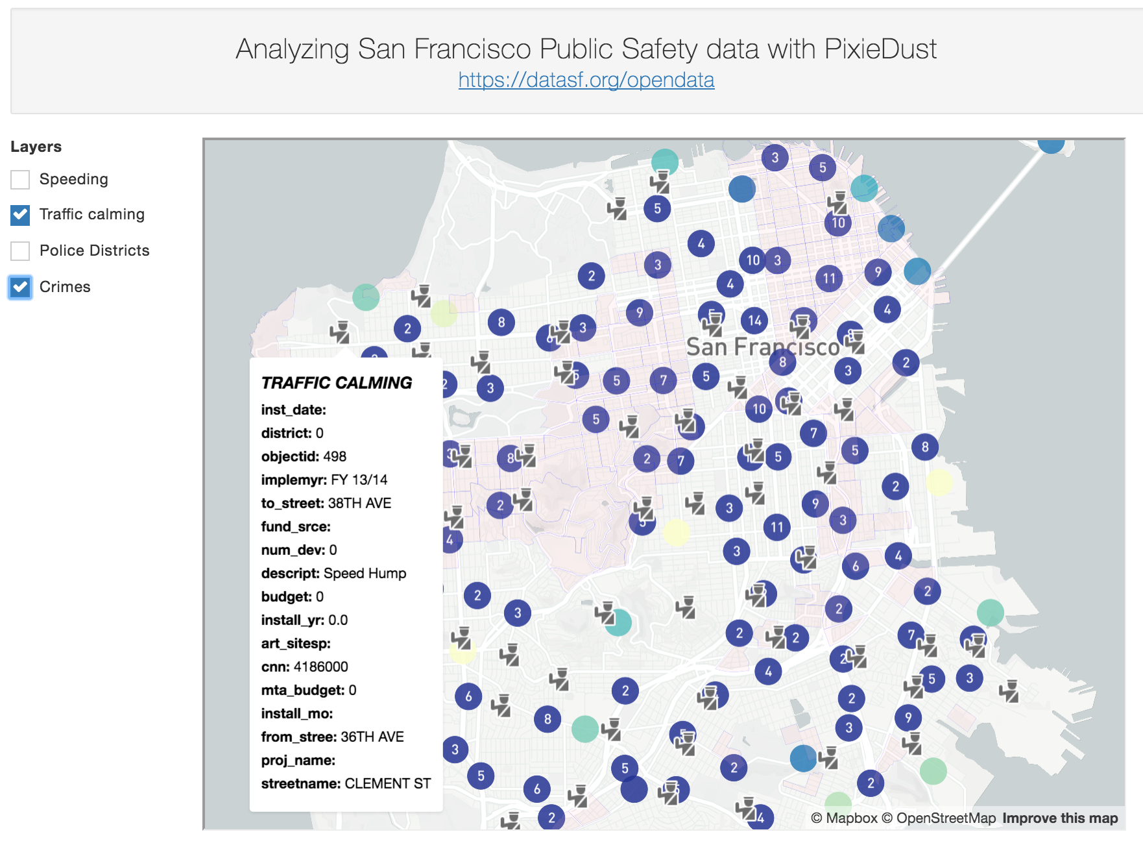
Run the PixieApp Dashboard
You can find the final code for the PixieApp in the complete notebook :http://ibm.biz/PixieDustBootcampSFNotebook

Slide 39
Final Thoughts
In this tutorial:
We showed how PixieDust help notebook users (data scientists or not) to load and visualize data without having to write code
We also showed how to use notebooks in new ways thanks to PixieApps by writing dashboard
Next Steps
Improve the analytics by finding new insights on the SF Traffic accidents dataset, or perhaps start a new notebook with a new dataset from https://datasf.org/opendata/
Improve the PixieApp dashboard by adding new layers. Just find the geojson link from the opendata site by clicking on the explore button (warning: not all datasets come with a geojson link). Then just add a new entry in the layers array

